Slide 1
R In Supply Chain: Intro to Supply Chain Network Design
Ralph Asher
ralph@datadrivensupplychain.com
January 18, 2022

Slide 2

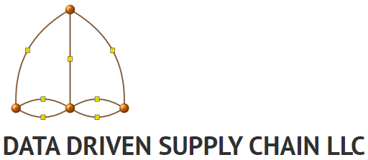
Who Am I?
MS Operations Research, Florida Inst. Tech. 2012
US Marine Corps, 2006-2012 (Full-Time / Active Duty), 2013-Present (Part-Time / Reservist)
General Mills & Target: Supply Chain Design & Simulation (2013-2021)
Data Driven Supply Chain LLC: Consulting & Training in Supply Chain Analytics, Design, Optimization and Simulation
www.datadrivensupplychain.com
Adjunct @ University of Minnesota, Carlson School of Management
R user since 2012
Math, maps, and coding enthusiast since childhood
USSR, MS-DOS, BASIC, and other antiquated acronyms

Slide 3
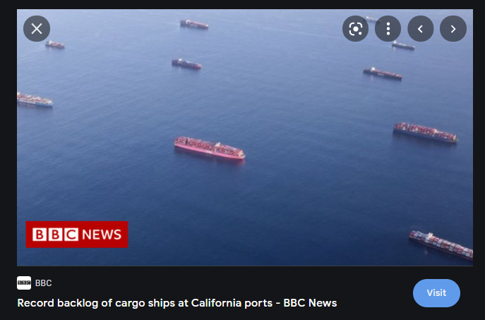
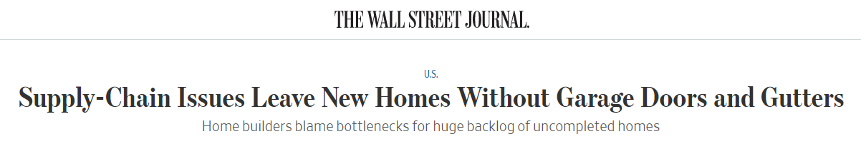
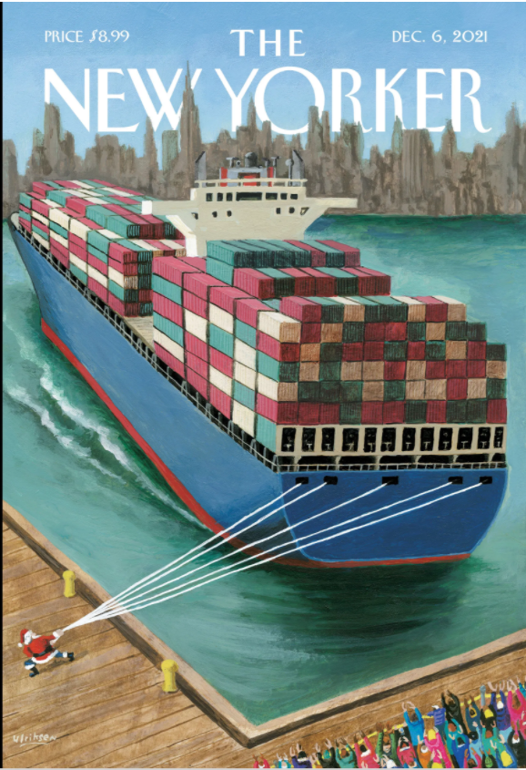
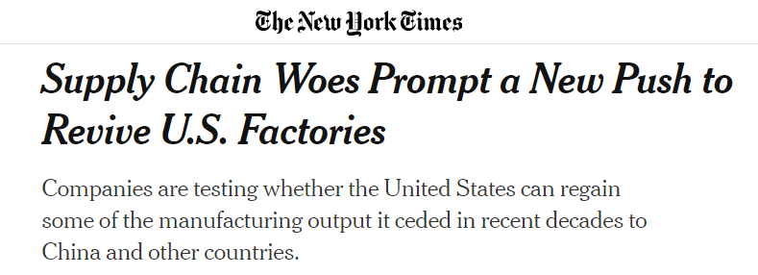
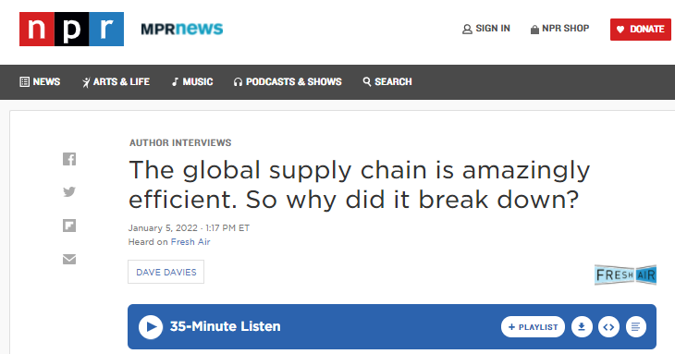

Supply Chains… From Back Office to the Front Page
Notes:
From the back office to the front pages.

Slide 4
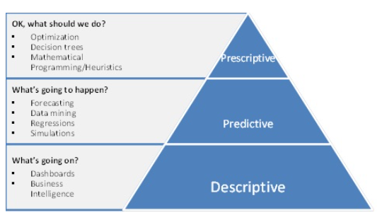
How Can Analytics Be Used in Supply Chain Management?
Supply Chain Network Design
Inventory Optimization
Manufacturing Optimization
Supply Chain Simulation
Sales Forecasting
Cost Input Forecasting
Supply Chain Simulations
BI & Diagnostic Analytics
Open-Source Technologies Are Changing the Game Across the Spectrum of Supply Chain Management Activities

Slide 5
What is Supply Chain Network Design?
Strategic analysis of the locations and activities of the various elements of a firm’s supply chain:
Warehouses for Raw Materials & Semi-Finished Goods
Manufacturing Facilities (Plants or Factories)
Distribution Centers (Warehouses) for Finished Goods
Retail Stores
All with the intent to understand the impacts on profitability, cost, service, and other key metrics; and with a goal to minimize or maximize one or two key metrics (usually cost or profitability).

Slide 6
Distribution Network Design
Given a customer base of demand (aggregated to a city level):
Where should we open Distribution Center(s) to satisfy that demand?
How much volume should each Distribution Center contain?
What customer should be serviced by (“aligned to”) each Distribution Center?
Two “echelons” of the supply chain: Distribution Centers and Customers

Slide 7
How Do We Do This?
Optimization modeling is a mathematical technique that allows a practitioner to optimize a set of interconnected decisions, where the decisions are constrained by real-world limitations. Optimization solvers take the set of decisions, formulated as a mathematical model, and return the set of decisions that optimizes (minimizes or maximizes) an equation (“objective function”) that includes the decisions as inputs.

Slide 8
Decision Variables
A modeler will define decision variables, numbers that either directly represent the decisions they want to make, or facilitate the constraints.
The optimization model will determine the values of all decision variables that yield the optimal value of the objective function.
Decision variables can be three main types:
Continuous: any real value, possibly within user-defined upper or lower bounds
Integer: any integer value, possibly within user-defined upper or lower bounds
Binary: only 0 or 1

Slide 9
Constraints and Objective Function
Constraints are mathematical (in)equalities that either represent real-world relationships between decision variables, or facilitate other constraints.
Constraints can be of form ≤, ≥, or =. Never < or >.
The objective function is a function of one or more decision variables that the optimization model is tasked with maximizing or minimizing.
The model changes decision variables, within constraints, to maximize or minimize this expression.

Slide 10
Optimization Model Types
The types of decision variables, and the form of the constraints and objective function, will determine what type optimization model you have.
Linear Programming (LP) model: only continuous decision variables, all constraints and the objective function are linear
Mixed Integer Programming (MIP) model: at least some decision variables are binary or integer, all constraints and the objective function are linear
Nonlinear Programming (NLP) model: At least one term in the constraints or objective function are nonlinear (e.g., two decision variables multiplied by each other, or a decision variable raised to an exponent other than 1)
Today we will be demoing a Mixed Integer Programming model

Slide 11
Heartland Widgets, Inc.
Decisions:
How many Distribution Centers to open, and where to locate them?
What customers to align to each Distribution Center?
Limitations (Constraints):
All Customer demand must be met
Minimum or maximum number of Distribution Centers (DCs)
Distribution Centers may be only realistically opened in certain locations
Maximum volume per Distribution Center (capacity)
Maximum distance from a Customer to its servicing Distribution Center

Slide 12
Heartland Widgets, Inc.
You are a Supply Chain Data Scientist at Heartland Widgets, Inc. Your company is the market leader in widget sales across an eight-state area of the American Midwest.
The pandemic-induced shift in consumer demand from services to goods, as well as stay-at-home orders, has led to a boom in demand for your company’s flagship product, the @HomeWidget.
Faced with record demand, the Director of Supply Chain Network Planning has asked you to “re-imagine” the company’s distribution network.
You are to recommend where to open Heartland’s Distribution Centers, as well as customer-DC alignment, at minimal cost.

Slide 13
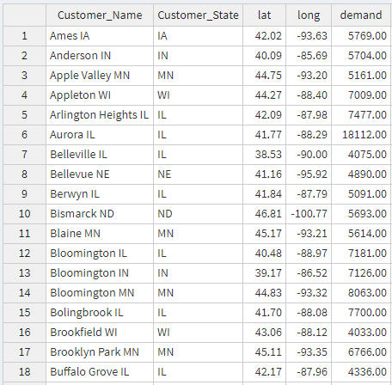
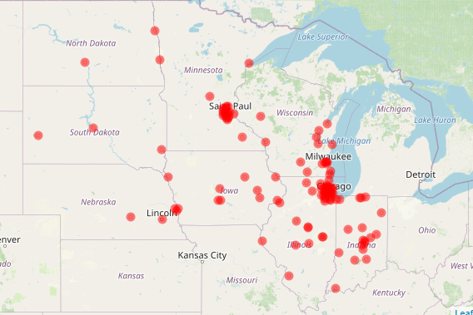
Heartland Widgets: Customer Demand By City
117 Midwestern Cities in Demand Table
Demand is Proportional to Population
Demand table created using maps::us.cities

Slide 14
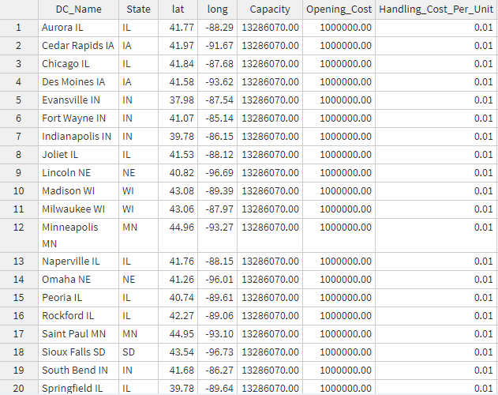
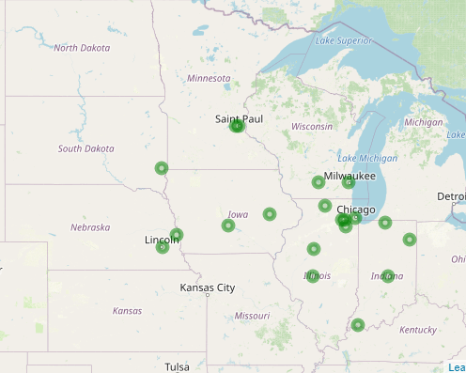
Heartland Widgets: Potential Distribution Center Locations
Top 20 Cities (by Demand) in Midwest are considered for DC Locations
Each DC is assumed to cost $1 Million to open

Slide 15
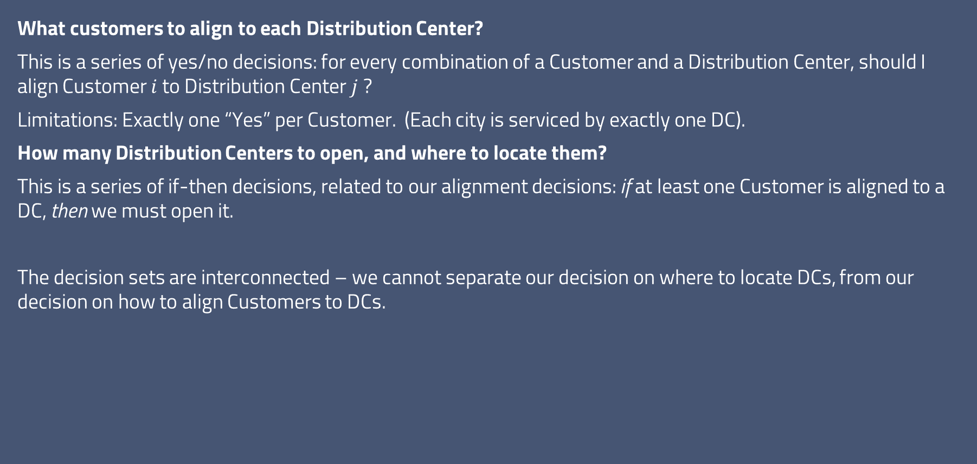
Heartland Widget Distributors, Inc.
What customers to align to each Distribution Center?
This is a series of yes/no decisions: for every combination of a Customer and a Distribution Center, should I align Customer $i$ to Distribution Center $j$ ?
Limitations: Exactly one “Yes” per Customer. (Each city is serviced by exactly one DC).
How many Distribution Centers to open, and where to locate them?
This is a series of if-then decisions, related to our alignment decisions: if at least one Customer is aligned to a DC, then we must open it.
The decision sets are interconnected – we cannot separate our decision on where to locate DCs, from our decision on how to align Customers to DCs.
 | DC: Chicago IL | DC: Indianapolis IN | DC: Minneapolis MN
Customer: Ames IA | Align? Y/N | Align? Y/N | Align? Y/N
Customer: Anderson IN | Align? Y/N | Align? Y/N | Align? Y/N
Customer: Apple Valley MN | Align? Y/N | Align? Y/N | Align? Y/N
Customer: Appleton WI | Align? Y/N | Align? Y/N | Align? Y/N
Customer: Arlington Heights IL | Align? Y/N | Align? Y/N | Align? Y/N
Customer: Aurora IL | Align? Y/N | Align? Y/N | Align? Y/N
Table abridged for presentation

Slide 16
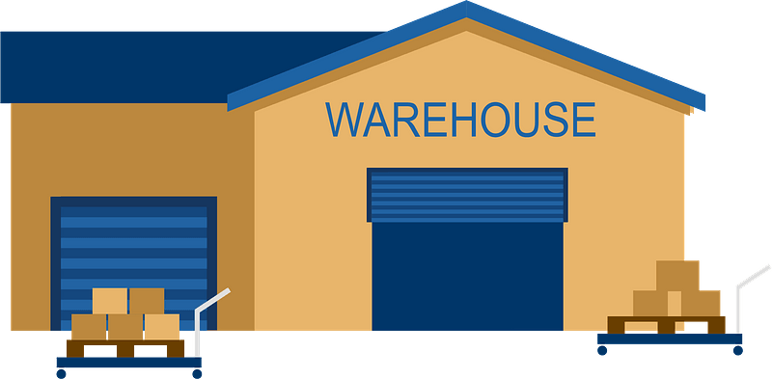



Heartland Widget Distributors, Inc.
Distribution Center Opening Costs ($1M each)
Distribution Center Handling Costs ($0.01 Per Unit)
DC-to-Customer Transportation Costs ($0.05 Per Unit-Mile.
e.g., 2 units traveling 100 miles = 2*100 = 200 unit-miles → $10 cost)
Total Supply Chain Cost
Optimization modeling helps us to find the set of interconnected decisions – which Distribution Centers to open, and which Customers to align with each Distribution Center – that minimizes the Total Supply Chain Cost

Slide 17
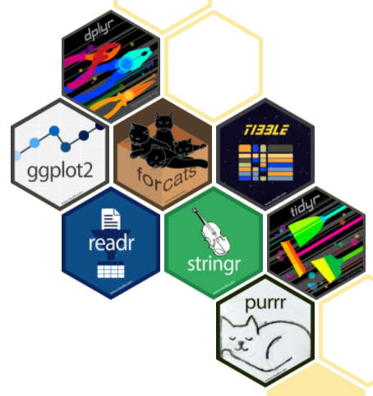
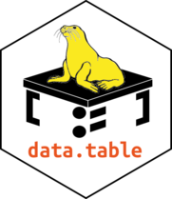
R Packages Used
Data Import, Prep, Analysis, & Export
tidyverse: dplyr, tidyr, & magrittr
vroom
DT
openxlsx
Data Visualization
shinydashboard
rhandsontable (interactive tables in Shiny)
leaflet & leaflet.minicharts (mapping)
Shinybusy (busy bar)
Optimization
ompr & ompr.roi (linear optimization modeling framework)
ROI.plugin.symphony (model solver: Support the COIN-OR Foundation! github.com/coin-or to donate)
Geospatial Analysis
geosphere
measurements

Slide 18
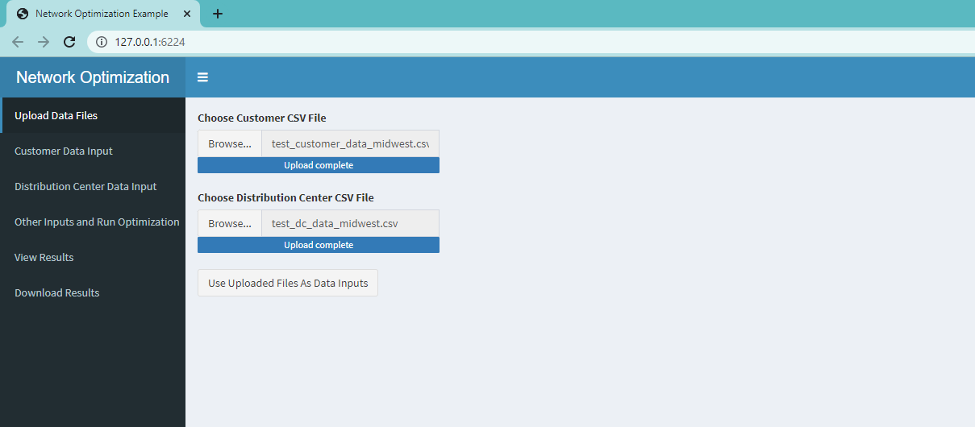
Shiny App: Upload Input Files
Step 1
Upload Customer Data CSV
Upload Distribution Center Data CSV
Click “Use Uploaded Files As Data Inputs”

Slide 19
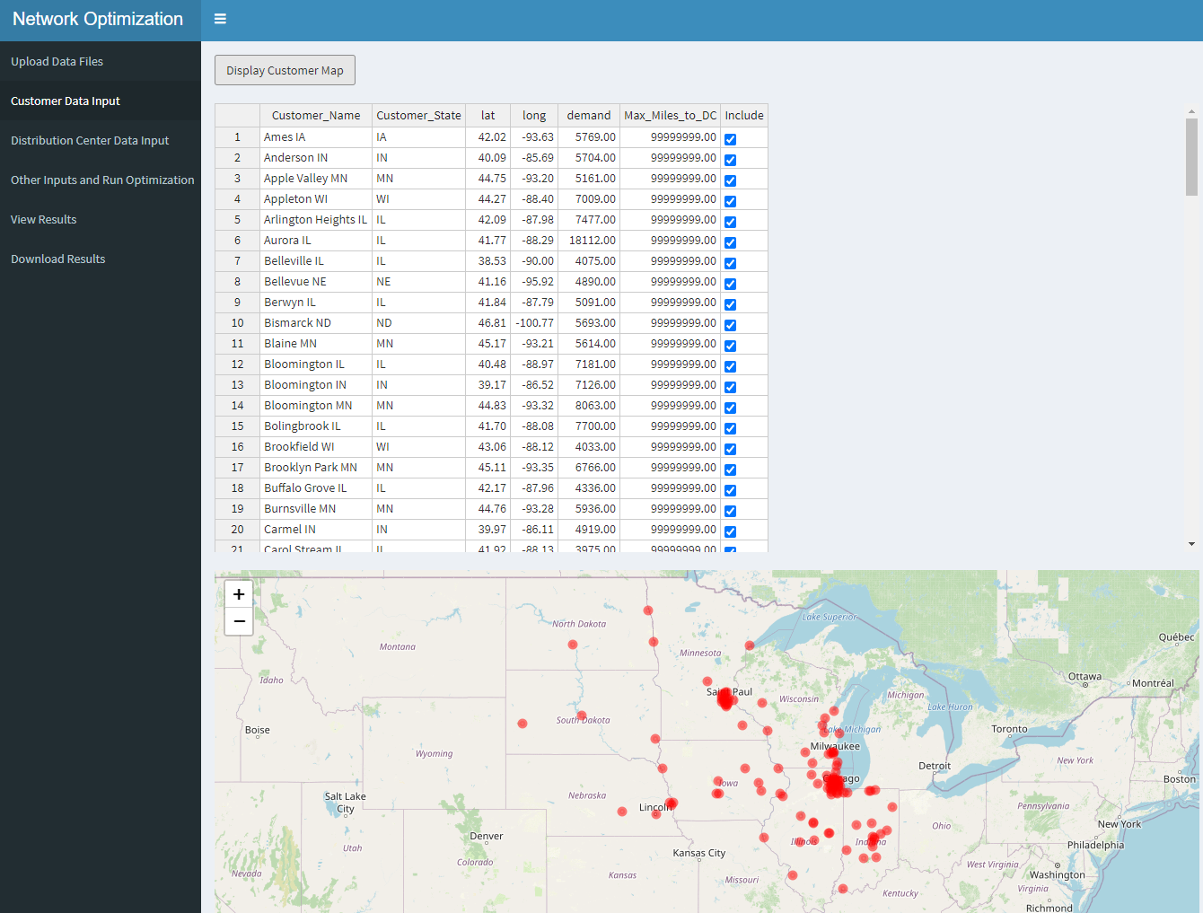
Shiny App: Check Inputs
Step 2
Review Customer Dataset
Make Adjustments As Needed

Slide 20
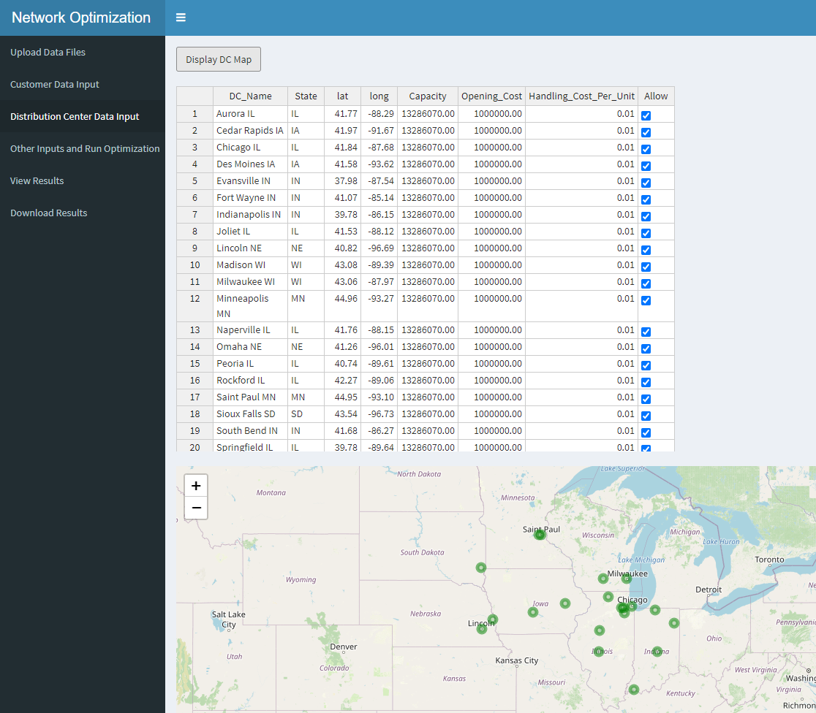
Shiny App: Check Inputs
Step 3
Review Distribution Center Dataset Make Adjustments As Needed

Slide 21
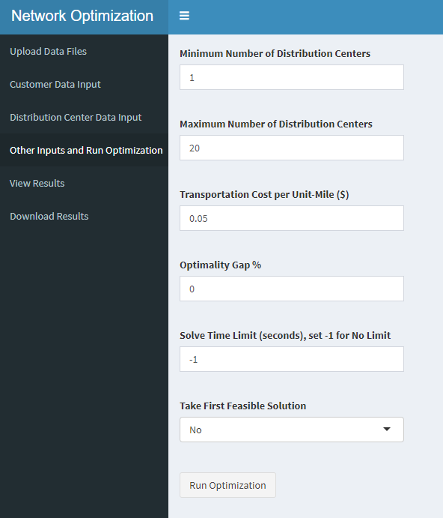
Shiny App: Adjust Settings
Step 4
Set Minimum Number of Distribution Centers to 1, Maximum to 20
Only 20 options… so this is as unconstrained as possible
Click Run Optimization

Slide 22
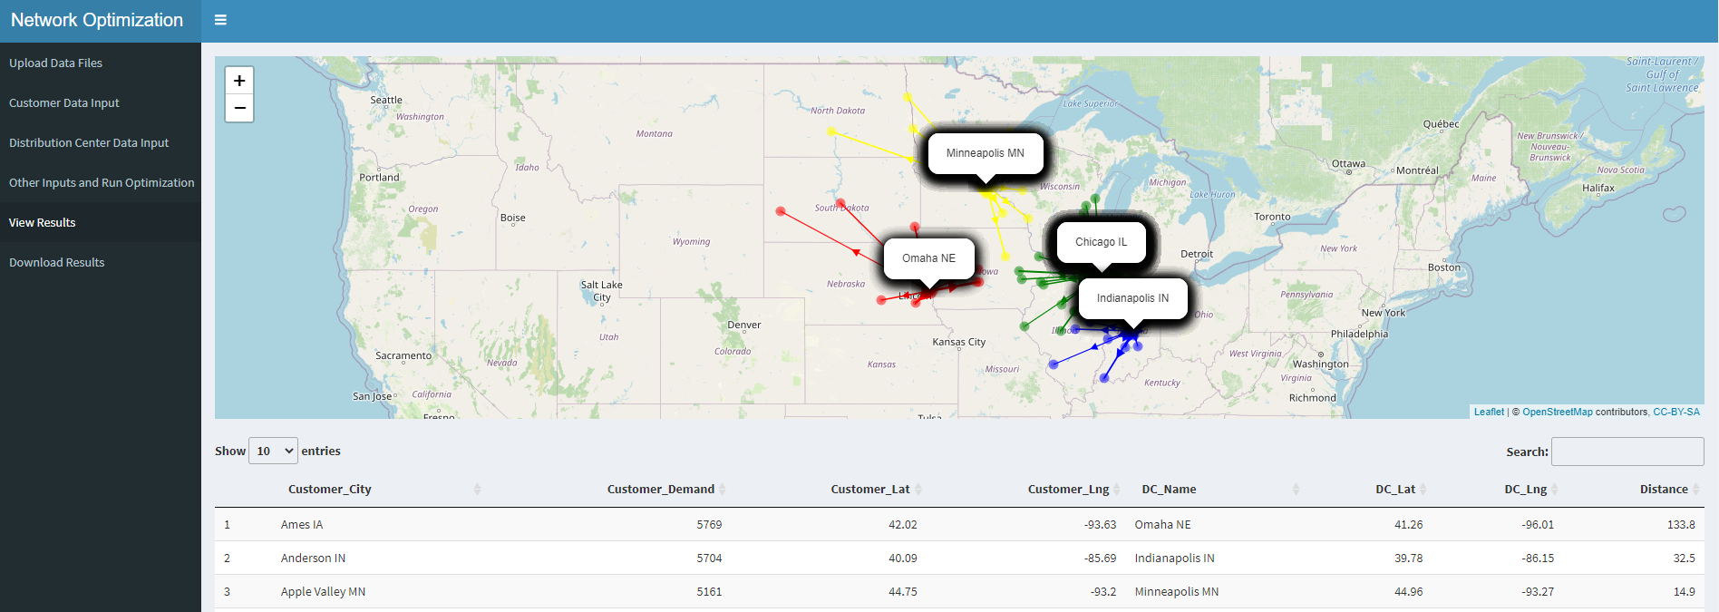
Shiny App: Results
Minimal Cost to Serve All Customers:
4 * $1M = $4,000,000 DC Opening Costs +
$3.5M DC-to-Customer Transportation Costs +
$13,286 DC Handling Costs =
$7.506M Total Cost
Loosest Constraints

Slide 23
A Side Discussion About Constraints…
In optimization modeling, constraints are mathematical limitations on what set of decisions you can make, that correspond to real-life limitations.
The more constraints you have in your model (and in real life), the worse your objective function becomes.
Optimization modeling, including supply chain network design, is an exercise in understanding the tradeoffs involved in tightening or loosening constraints.
In designing your supply chain, the tighter the constraints, the higher the total cost becomes. Supply Chain Design is partly an art around understanding the additional expenses associated with tighter constraints.

Slide 24
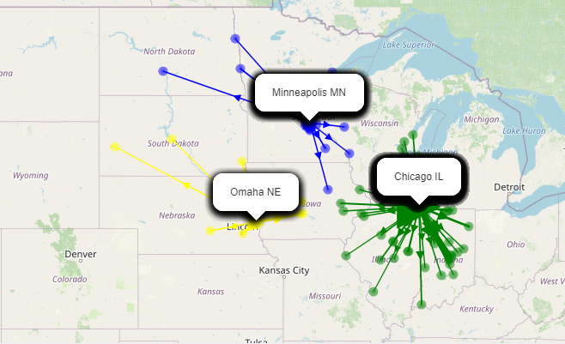
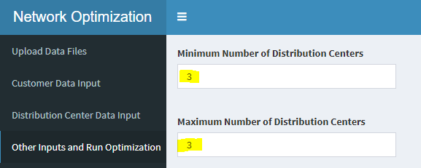
Shiny App: Requiring Exactly 3 DCs Opened
When we set the constraint to allow between 1 and 20 DCs, the Total Cost was $7.5M and 4 DCs were recommended
When we require exactly 3 DCs (tighter constraint), the Total Cost rises $125K to $7.6M.
Tighter Constraints → Higher Cost (Worse Objective Function)

Slide 25
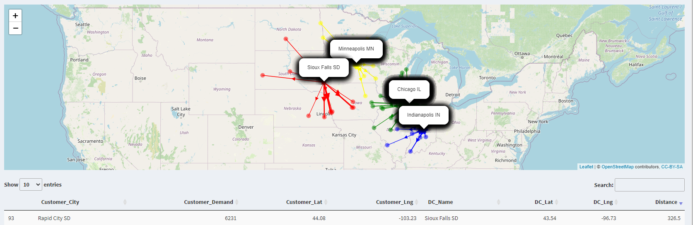
Shiny App: Max 400 Miles to DC
When the max distance to the Distribution Center was set to 99,999,999 miles, the max distance from a DC to a Customer was 415.6 miles. What if we set the max distance to 400 miles?

Slide 26
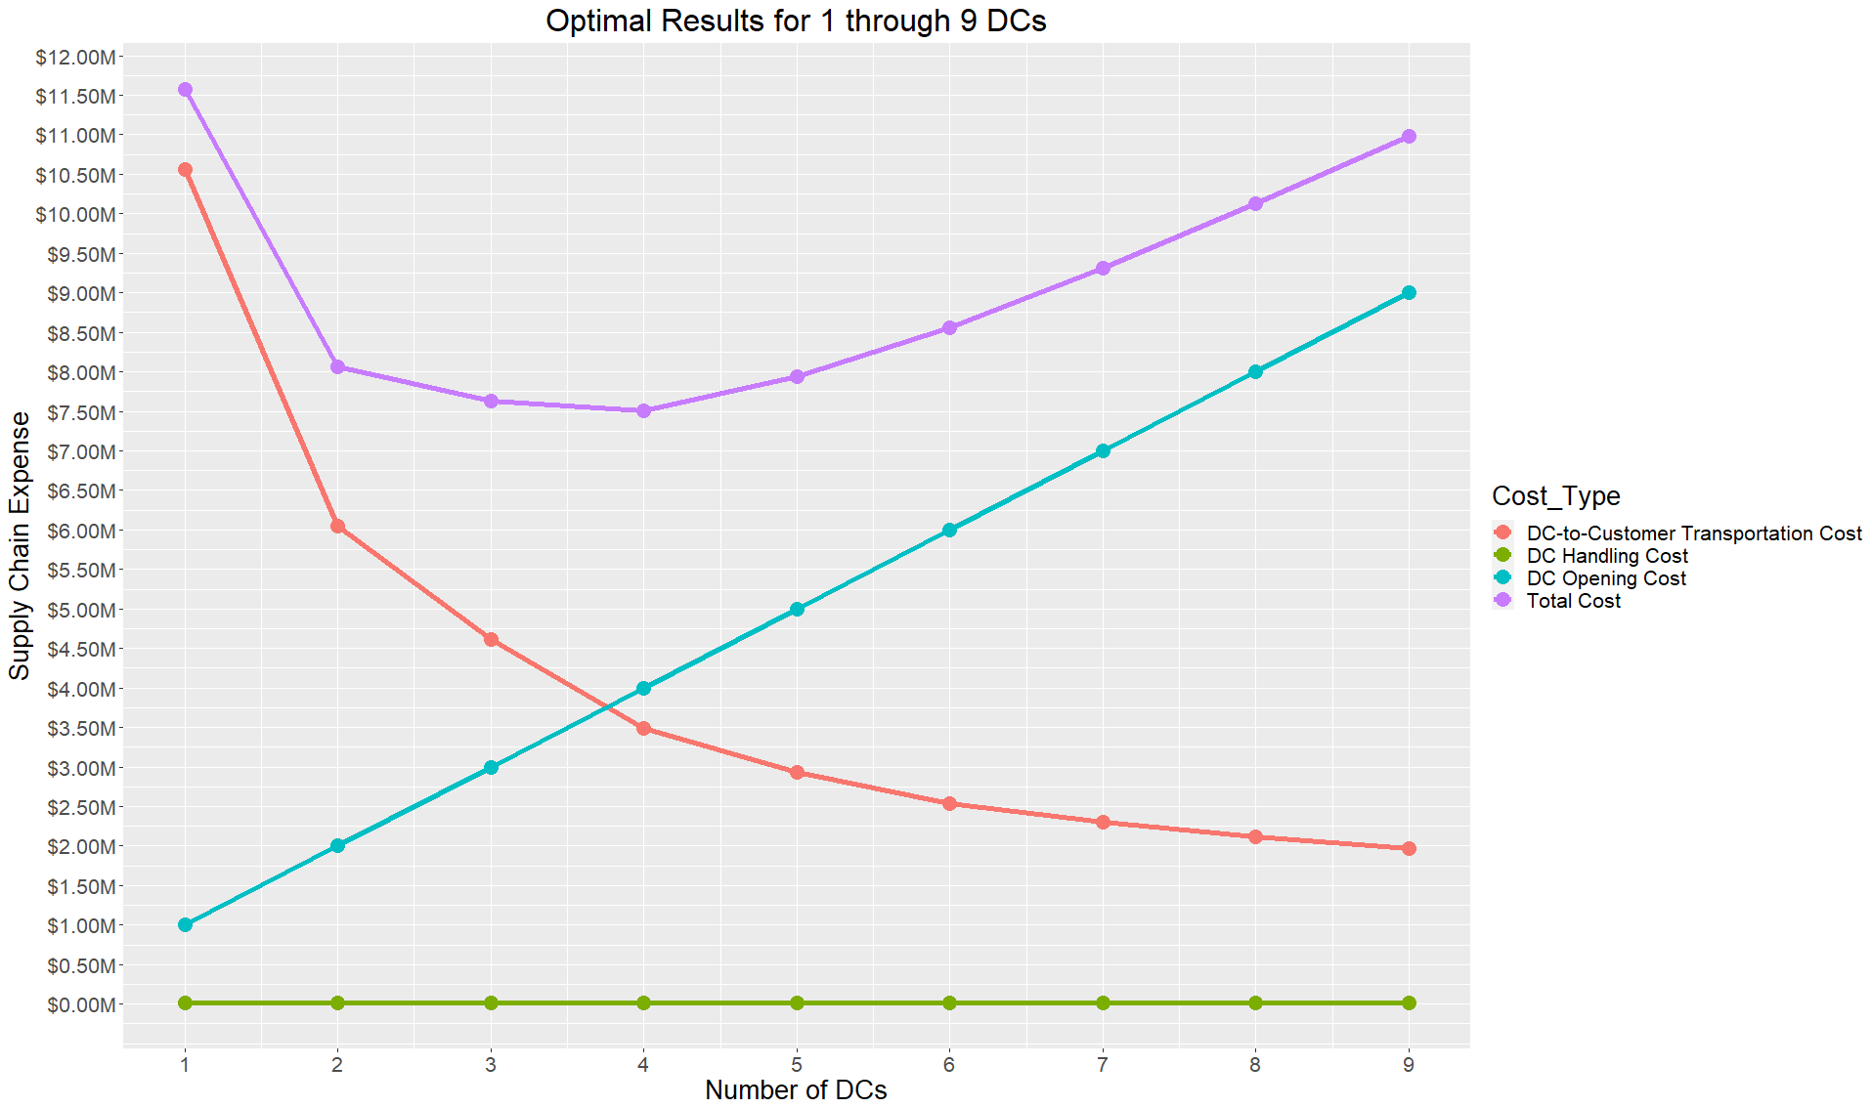
Shiny App: Tradeoffs In Cost Functions
Minimal Total Cost Occurs at 4 DCs

Slide 27
Conclusion
Supply Chain Management, once a “behind-the-scenes” corporate function, is now front-page news.
Analytics, powered by open-source programming languages like R and Python, are changing the nature of Supply Chain Management
Supply Chain Network Design is a powerful tool in devising and evaluating your organization’s supply chain strategy

Slide 28
Thank you for listening!
ralph@datadrivensupplychain.com
www.datadrivensupplychain.com
https://www.linkedin.com/company/data-driven-supply-chain
https://www.linkedin.com/in/ralphasher/

Slide 29
Appendix / Extra Slides

Slide 30
Agenda
Introduction
What is Supply Chain Management? How can analytics be used in Supply Chain Management?
What is Supply Chain Network Design?
Example Supply Chain Network Design & Shiny App
Closing

Slide 31
What is Supply Chain Management?
Council of Supply Chain Management Professionals (CSCMP) Definition:
“Supply chain management encompasses the planning and management of all activities involved in sourcing and procurement, conversion, and all logistics management activities. Importantly, it also includes coordination and collaboration with channel partners, which can be suppliers, intermediaries, third party service providers, and customers. In essence, supply chain management integrates supply and demand management within and across companies.”
https://cscmp.org/CSCMP/Educate/SCM_Definitions_and_Glossary_of_Terms.aspx

Slide 32
How Can Analytics Be Used in Supply Chain Management?
Business Intelligence
Sales & Operations Planning
Sales Forecasting
Cost Input Forecasting
Inventory Planning & Optimization
Supply Chain Network Design
Manufacturing Networks
Distribution Networks
Supply Chain Simulation
Open-Source Technologies Are Changing the Game Across the Spectrum of Supply Chain Management Activities

Slide 33
What is Supply Chain Network Design?
Manufacturing Network Design
Where should we build a plant?
What products should produce at each plant?
What should our manufacturing capacity be by product, and by plant?
Distribution Center Network Design
Where should we open Distribution Centers?
What products and quantity (inventory) should we hold at each Distribution Center?
What should our Distribution Center capacity be?
What customers should be serviced by (“aligned to”) each Distribution Center?

Slide 34
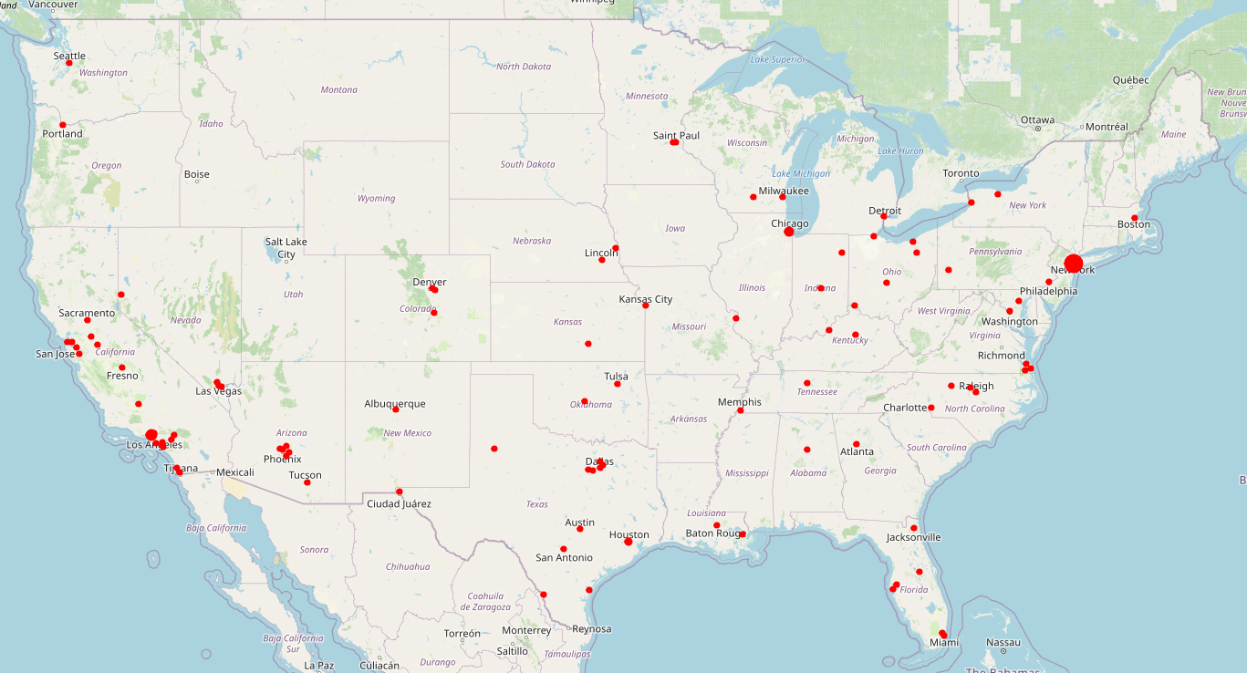
Two-Echelon Distribution Center Network Design

Slide 35

Two-Echelon Distribution Center Network Design

Slide 36
Vacation Flights & Constraints
$250 Lowest-Cost Flight: Depart at 6am Tuesday, 5 hour layover, 2 hour drive to hotel.
No way I’m leaving before noon on Tuesday…
$350 Lowest-Cost Flight: Depart at 10am Thursday, 2 hour layover, 2 hour drive to hotel.
Wow, I really don’t want to drive that far to the hotel…
$500 Lowest-Cost Flight: Depart at 5pm Friday, direct flight, airport shuttle to the hotel.
As your flight requirements (constraints) become stricter, the cost goes up: there are fewer choices, so the lowest cost choice can only get more expensive.
In designing your supply chain, the tighter the constraints, the higher the total cost becomes. Supply Chain Design is partly an art around understanding the tradeoffs between constraints and expense.

